Slide 1
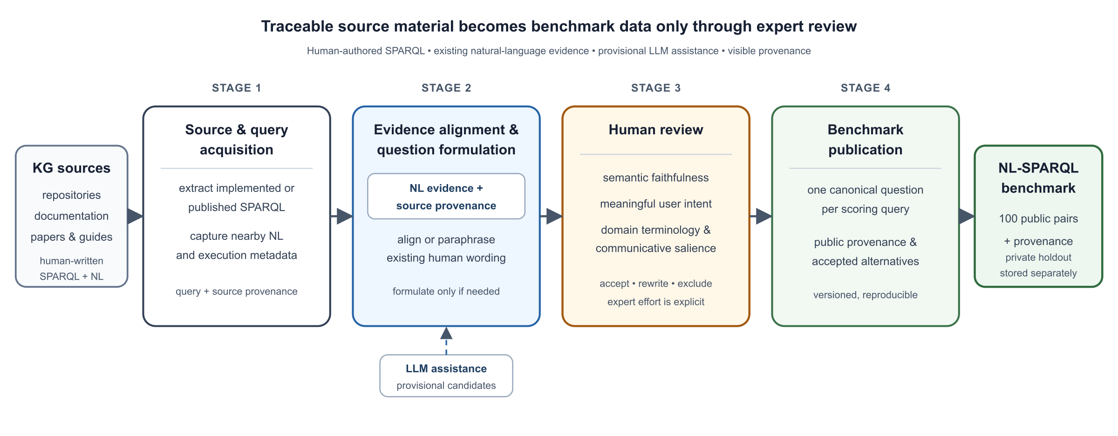
Musparql
WORKSHOP FOCUS
Human review turns provisional wording into benchmark data
Notes:
Source figure: docs/papers/scik-2026/scik-2026-musparql-workflow.svg and its paper-rendered PNG. Paper title used in the MTSR manuscript: ‘Provenance-Aware Curation of NL-SPARQL Evaluation Data for Domain Knowledge Graphs’, Polina Proutskova, 2026. Figure caption: The four-stage Musparql workflow. Human-authored SPARQL is collected with source provenance; existing natural-language evidence is aligned before new wording is formulated; expert review determines semantic and communicative adequacy; and publication separates compact scoring pairs from richer provenance. LLM assistance is confined to Stage 2 and cannot publish a benchmark item without Stage 3.

Slide 2
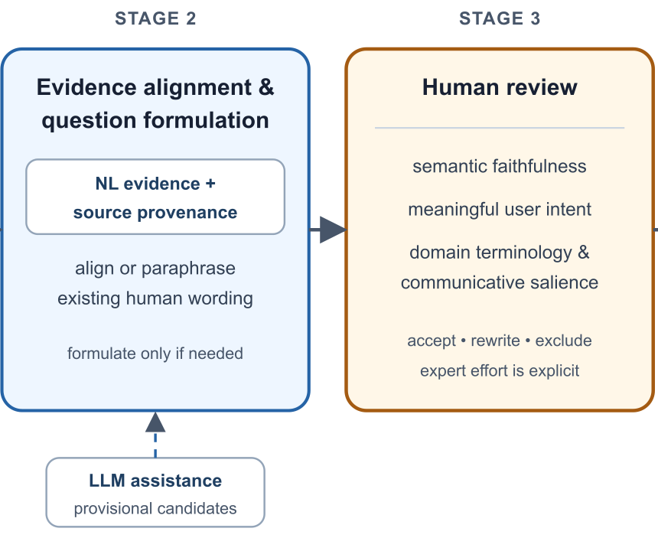
Musparql
The review gate
Today we work at Stage 3
Check whether the question matches the SPARQL
Correct terminology and missing meaning
Accept, rewrite or exclude the candidate
Next: live workshop pipeline
Notes:
This slide enlarges Stages 2 and 3 from Figure 1 to introduce the live workshop demonstration. The three review prompts summarize the paper’s Human Review section.

Slide 3
Musparql
The ambiguity sidecar
SCORING FILE
Why keep both layers?
One canonical question
“What tracks are on the release ‘On Broadway, Vol. 1’, and for each track, who performed it, when was it recorded, and where?”
The scoring benchmark stays simple. The sidecar preserves valid linguistic variation for audit and research.
PUBLIC SIDECAR · alternatives.jsonl
OUTLOOK
The same query keeps multiple reviewed formulations
Linguistic dimensions
Two non-literal formulations are rated against the literal anchor at 0.
LITERAL REFERENCE
“What tracks are on the release … and for each track, which band performed it, when was it recorded, and where?”
Naturalness
ACCEPTED ALTERNATIVE
“Where, when and by whom were the tracks on the album ‘On Broadway, Vol. 1’ recorded?”
formal ↔ fluent
Pragmatism
exhaustive ↔ salient
Each formulation remains linked to the same versioned SPARQL and review provenance.
Room for interpretation
constrained ↔ open
More open does not mean better.
Notes:
Content sources: benchmark/v10/alternatives.jsonl, record jazzontology-0016; docs/DATA_MODEL.md; docs/LINGUISTIC_DIMENSIONS_WORKBENCH_SPEC.md. The accepted-alternative example normalizes a duplicated terminal question mark in the stored record. Talking point: the compact scoring file publishes one canonical question, while the public sidecar retains the validated literal wording and human-accepted alternatives with provenance. The linguistic-dimensions experiment compares two non-literal formulations against the literal anchor on naturalness, pragmatism, and room for interpretation.

